Slide 1

Learning Emotions
A Software Engine for Simulating Realistic Emotion in Artificial Agents
Douglas Code
Department of Mathematics and Computer Science
Advisor: Dr. Denise Byrnes

Slide 2
Research Goals
Evaluate cognitive and computational models of emotion
Design system for modeling emotions in simulated agents
Map external events -> emotional response
Implement domain-generic engine based on model
Implement visualization of core model functions

Slide 3
Research Applications
Gaming
Populated, dynamic worlds
Simulation
Realistic modeling of social situations, large populations
Interactive AI
Siri, Google Now
Tutoring

Slide 4
Fuzzy Logic
Logic system with partial set membership
A crisp input value may partially belong to multiple fuzzy sets
Ex.: A temperature (65°F is both warm and cool to some degree)
Fuzzy logic systems map crisp inputs to crisp outputs
Crisp inputs converted to fuzzy set values
Fuzzy inputs run through inference engine
Fuzzy outputs run through defuzzifier to yield crisp outputs
(Zeynep, 2006)

Slide 5
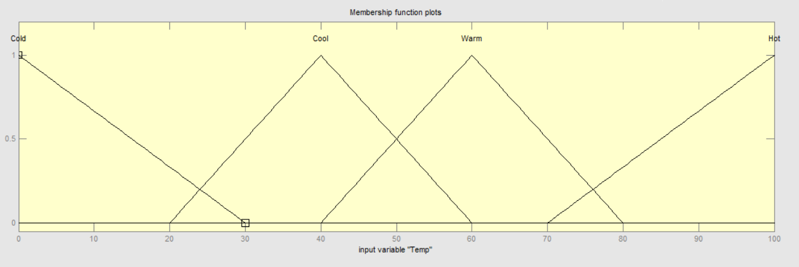
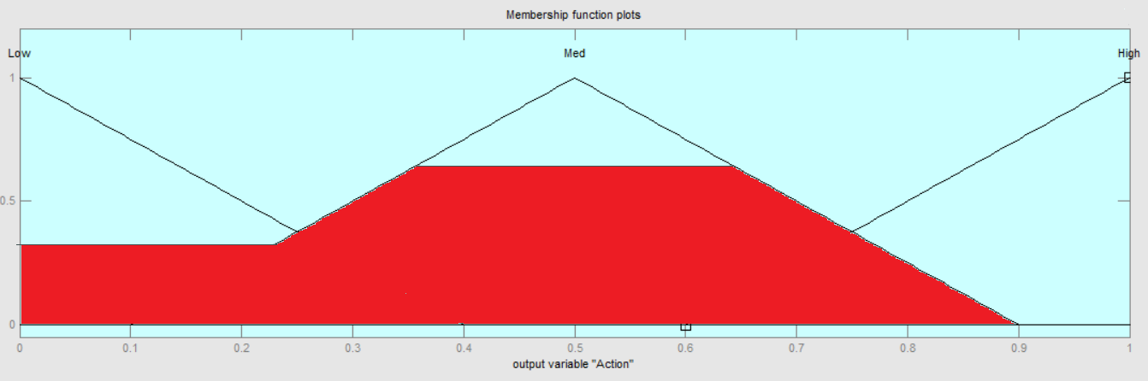
Fuzzy Logic
Fuzzifier
Determine set membership from crisp input
Inference Engine
Use logical rules to map fuzzy inputs to fuzzy outputs
Ex: If TEMP is WARM and OCCUPIED is HIGH then FAN STRENGTH is HIGH
Deffuzifier
Maps fuzzy outputs to a crisp output
Many techniques for calculating/estimating center of mass of outputs

Slide 6
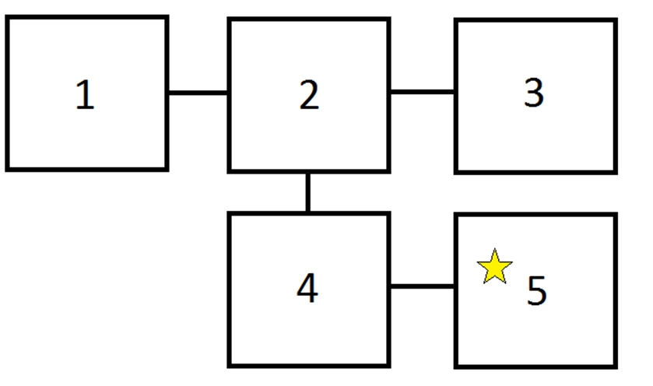
Q-Learning
Machine learning technique for learning about sequences of actions
Individual should be able to reason about actions and events causing non-immediate results
Recursive function that maximizes reward over time
Based on state changes
Converges to optimal solution in deterministic setting

Slide 7
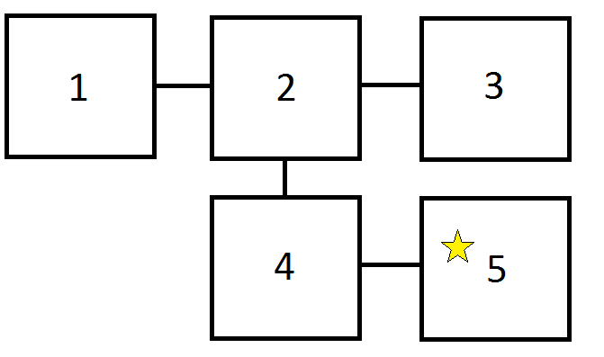

Q-Learning
Recursive function for Q-value
$Q\left(s,a\right)=r\left(s,a\right)+$ymax_{a’}(Q(s’,a’))
r(s,a) is reward for action in current state
s’, a’ are subsequent state and action
Algorithm
Choose an action
Evaluate resulting reward/punishment
Calculate Q-value of current state
Update memory table with new value
Choose next action

Slide 8
FLAME Model - Overview
Computational model of emotion
Rooted in appraisal theory
Emotions come from changes in perception caused by external events
Key differences
Heavy use of fuzzy logic
Learning is fundamental to emotion

Slide 9
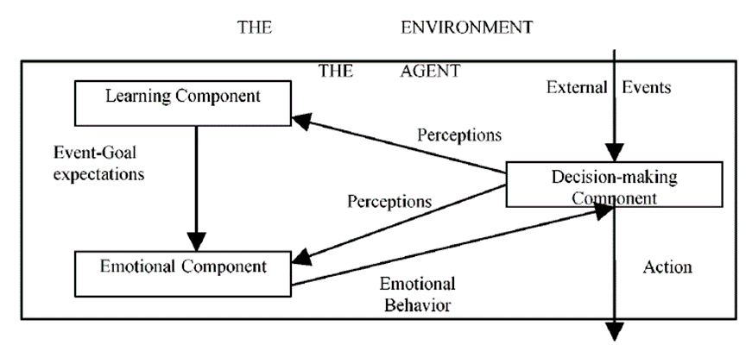
FLAME Model - Design
Two primary internal components
Learning
Emotional
Decision-making component determined externally based on domain
External events are sent to both internal components
Learning component informs action of emotional component
(El-Nasr et al., 2000)

Slide 10
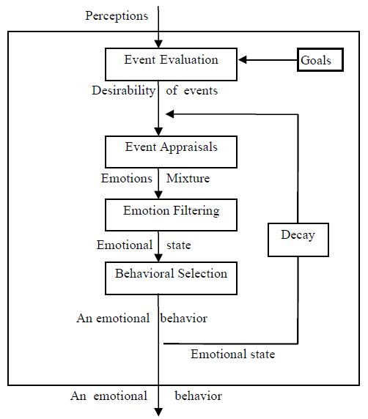
FLAME Model – Emotional Component
Emotional component maps perceived events to emotional behavior
Individual’s goals determine how it evaluates the desirability of events
First three modules determine emotional state, final determines behavior
Emotions are decayed between iterations
(El-Nasr et al., 2000)

Slide 11
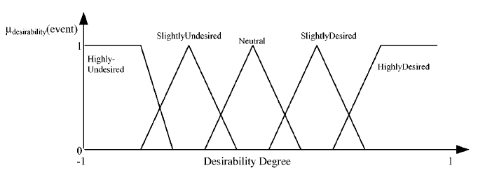
FLAME Model – Event Evaluation
Uses fuzzy logic
Inputs are Impact(Goal, Event) and Importance (Goal)
Output is Desirability(Event)
Desirability is used in next module (appraisal)
(El-Nasr et al., 2000)

Slide 12
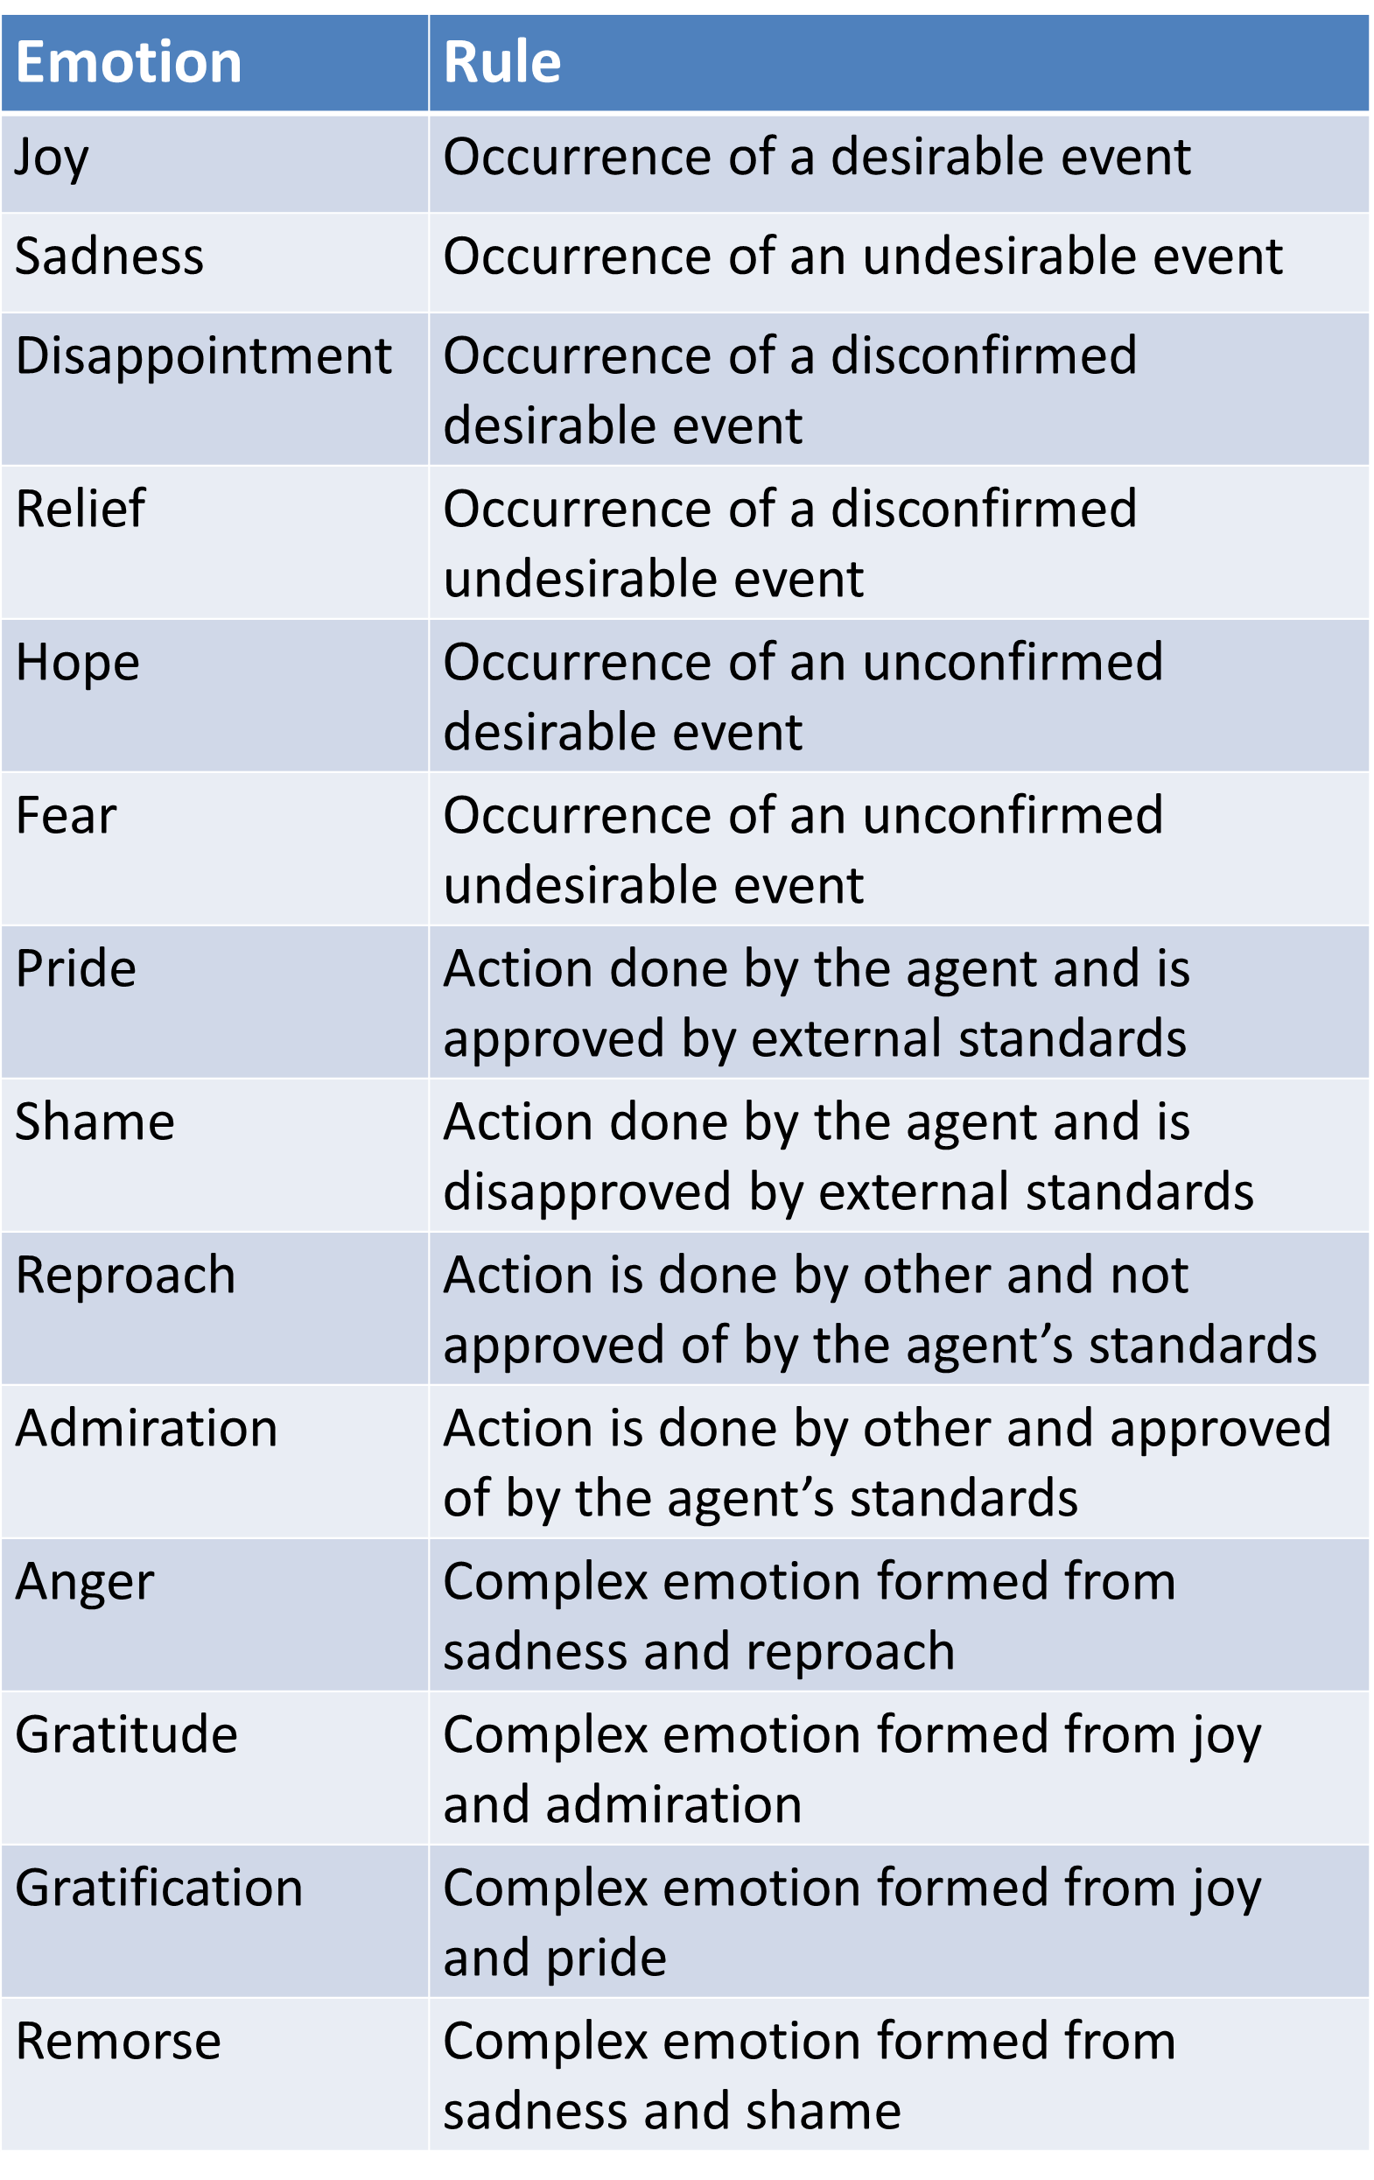
FLAME Model – Event Appraisal
Determines intensity of each modeled emotion
Emotion definitions are used to evaluate whether an emotion should be triggered
Intensity formulas determine strength of triggered emotion
Ex.: Fear = (2*Expectation²) – Desirability
Module output is an emotional state
(El-Nasr et al., 2000)

Slide 13
FLAME Model – Emotion Filtering
Motivational states can inhibit emotions
Ex.: Hunger inhibiting joy
Motivational states are domain-dependent and not defined by model
Fuzzy rules used to map motivational states to emotion suppression
Emotions can suppress opposing emotions
Previous emotions determine mood, which affects suppression

Slide 14
FLAME Model – Behavior Selection
Fuzzy rules map state to behavior
Inputs are Emotion Intensity, Event, and Cause
Output is Behavior
Incorporation of events and causes as inputs allow more complex behavior
Different responses to different individuals

Slide 15
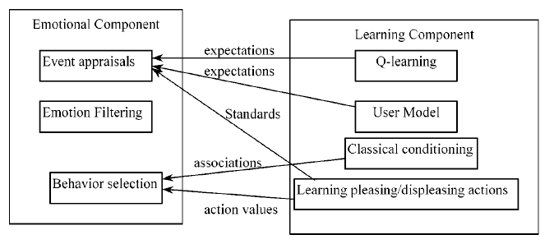
FLAME Model – Learning Component
Learning component adjusts perceptions based on experience
Determines expectation for events to occur
Determines social standards
Determines object associations
(El-Nasr et al., 2000)

Slide 16
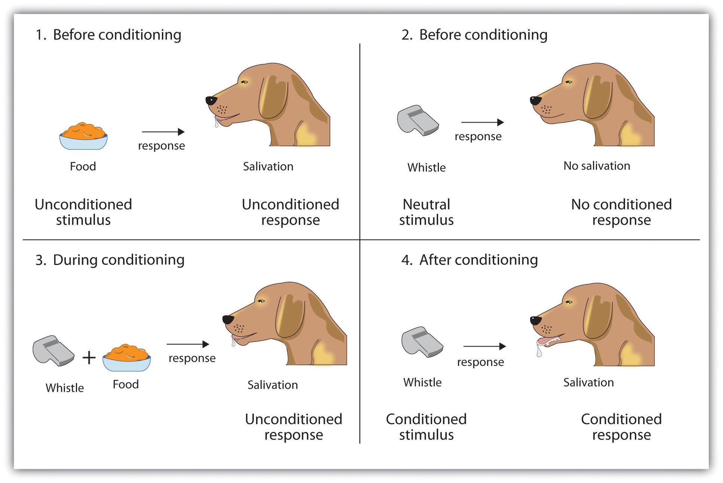
FLAME Model – Classical Conditioning
Formation of associations between neutral objects and emotions
Repeated experiences strengthen response to object
Response is average of emotional intensities of all past experiences
https://changecom.files.wordpress.com/2012/12/classical-conditioning.jpg

Slide 17
FLAME Model – Event Impacts
Individual must be able to reason about sequences of events
Form connections between original event and results that are not immediate
Uses Q-Learning
Modified for non-deterministic nature of problem
Expected reward modified by conditional probability of responses
Constant multiple based on mood matching

Slide 18
FLAME Model – Social Values
Social emotions are modeled by system
Pride, shame, reproach, admiration, anger, gratitude, gratification, remorse
Social responses are conditioned by past experiences
Social perception of action is average of all past feedback for that action
Ex.: Repeated negative feedback gives negative social perception of an action, triggers shame when individual carries out action

Slide 19
FLAME Model – User Model
Most models have hard-coded expectations
FLAME lets individual learn what events to expect
Past events stored in short term memory
Expectation of event is based on conditional probability of event based on events in memory

Slide 20
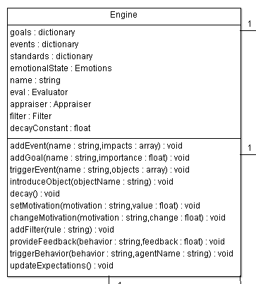
Software - Design
JavaScript engine for web applications
Goal: Easy incorporation into external software
Include .js file in HTML
Individual instance of emotional model in each agent
Engine class controls all API calls
Evaluator, Appraiser, Filter, BehaviorSelector, and FuzzySystem classes implement emotional and learning components

Slide 21
Software - API
Function | Example Code
Create new instance (individual) | var brain = new Engine(“Tim”, 0.3) ;
Add goal | brain.addGoal(“Win Race”, 0.5) ;
Add event | brain.addEvent(“Trip”, [“Win Race”, -0.3]) ;
Trigger event | brain.triggerEvent(“Start Race”, [“crowd”, ”gun”]) ;
Expose individual to an object | brain.introduceObject(“crowd”);
Add/set motivational state | brain.setMotivation(“Hunger”, 15) ;
Adjust motivational state | brain.changeMotivation(“Hunger”, -10) ;
Add inhibition rule | brain.addFilter(“Hunger > 30 THEN Pride”);
Give social feedback | brain.provideFeedback(“Win Race”, 3) ;
Trigger social response | brain.triggerBehavior(“Win Race”, “Tim”) ;
Get emotional state (Emotion:Intensity dictionary) | brain.getState();

Slide 22
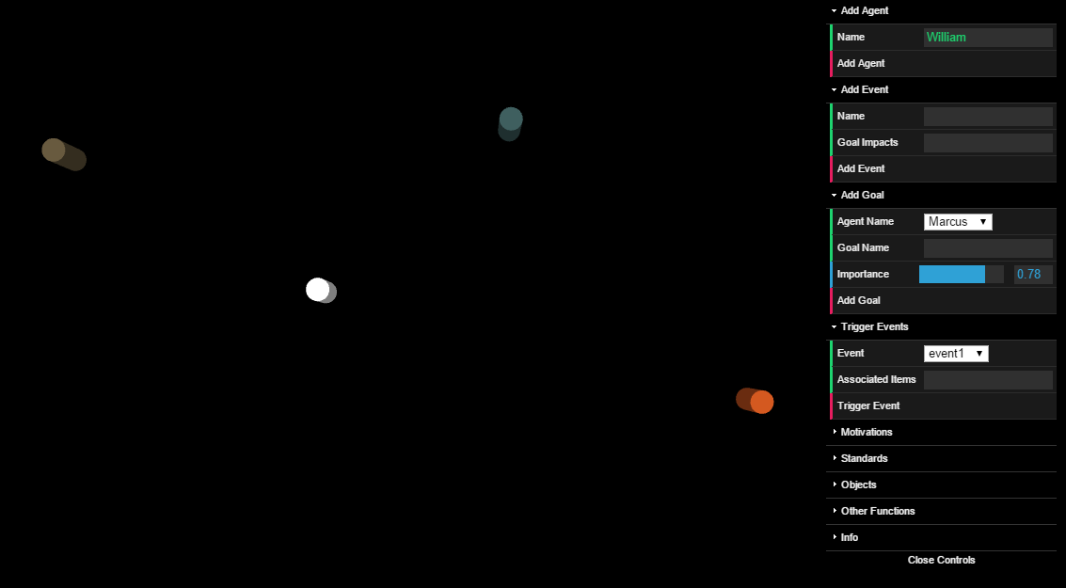
Software - Visualization
Three.js library and WebGL
Uses dat.gui and SweetAlert libraries for interface and custom popups
Supports all functions in the engine API
Individuals represented by colored cylinders
Color changes with emotion

Slide 23
Software Demo (In Browser)

